Slide 1

Team: TECH FORCE Designing a Scalable E-Commerce Platform for Buyers and Sellers
Project: DeLux Mart
1. N.Lavanya Sri (Y22CS125)
2. N.Durga Bhavani (Y22CS126)
3. O.Monik Paparao (Y22CS139)

Slide 2
CONTENTS
Problem Statement
Introduction
High Level Design
Low Level Design
Database Schema
Functional requirements
Non Functional Requirements
Conclusion

Slide 3
Problem Statement
Consumers need a seamless online shopping experienceto browse, search, and purchase products from multiplesellers in one platform.
Building a scalable system that supports a large numberof buyers and sellers simultaneously is complex.
The platform must handle diverse product catalogs andprovide fast, accurate search and browsing features.
Ensuring secure and reliable transactions acrossmultiple sellers adds to the challenge.

Slide 4
Introduction
Online shopping demand is rapidly increasing,requiring platforms to support many users and sellers.
Customers want a single platform to easily browseand buy products from multiple sellers.
Building a system that scales efficiently with largetraffic and diverse product catalogs is challenging.
Fast and accurate search functionality is critical for agood user experience.
Ensuring secure and reliable transactions is essentialfor trust and platform success.

Slide 5
High Level Design
Goal:
Develop a scalable and modular e-commerce platform.
Core Components:
Users (Customers)
Sellers
User Service
Product Service
Cart Service
Order Service
Authentication Service
Seller Dashboard Service

Slide 6
Technology Stack
Frontend: Angular, HTML, CSS
Backend: Express Js, Node.js
Database: MongoDB
Communication:
Messaging: Email
External Systems:
COD system for Payment

Slide 7
Overview of System Diagram
Product Display & Filtering
Cart System (Add/Remove)
Processing
Order Updates
Mail Updates
Authentication

Slide 8
Stakeholders:
End users (Buyers & Sellers)
Developers
Evaluators
Scope:
Product listing & browsing
Search and filtering
Shopping cart & checkout
Order updates
Reviews and ratings

Slide 9
Low Level Design – Key Entities
User:
Name
Email Id
Password
Product:
Filters
Search attributes
Cart:
Add/remove items
Quantity management

Slide 10
Payment:
Payment methods(COD)
Payment status
Seller:
Product dispatch
Amount collection
Delivery:
Order ID, Delivery OTP, Delivery status, Handover
Feedback & Queries:
The User can make contact to admin for queries.

Slide 11
Database Schema
Entities:
Users Table: Name,email, password
Product Table: ID, Name, Image, Email, Price, Uploaded time
Cart Table: Id Email, Product Id, Product Name, Product Image, Product Price, Quantity, Seller Email
Order Table: ID, Email, items,total amount, payment mode, Adrdess, Delivery OTP, Order Date, Oder Status, Delivery Status
Sellers Table: Id, Name, Email, Password

Slide 12
Functional Requirements
Scalability
System should handle growing numbers of users, products, and orders.
Performance
Fast response times for search, checkout, and product loading (<2 seconds preferred).
Reliability & Availability
High uptime (e.g., 99.9%) to ensure continuous service availability.
Security
Secure user authentication (OTP, encryption).
Safe handling of payment and personal data (e.g., SSL, tokenization).
Maintainability
Modular code and services for easy updates and debugging.

Slide 13
Usability
Intuitive UI/UX for both customers and sellers.
Compatibility
Responsive design across browsers and mobile devices.
Logging and Monitoring
Proper system logs for debugging and real-time monitoring of service health.
Data Consistency
All transactions (orders, payments, returns) should maintain data integrity.
Localization (Optional)
Support for multiple languages and currencies, if planning to scale globally.

Slide 14
Non-Functional Requirements
Scalability
System should handle growing numbers of users, products, and orders.
Performance
Fast response times for search, checkout, and product loading (<2 seconds preferred).
Reliability & Availability
High uptime (e.g., 99.9%) to ensure continuous service availability.
Security
Secure user authentication (OTP, encryption).
Safe handling of payment and personal data (e.g., SSL, tokenization).
Maintainability
Modular code and services for easy updates and debugging.

Slide 15
Usability
Intuitive, user-friendly UI/UX optimized for mobile and web platforms.
Clear navigation, accessible design, and fast-loading pages improve user satisfaction.
Reliability
System should automatically recover from service failures (auto-retry, health checks).
Order, payment, and delivery data must remain consistent even during failures.
Logging & Monitoring
All services should log key activities (e.g., logins, transactions, failures).
Monitoring tools (e.g., Prometheus, ELK stack) should track uptime, API response times, and error rates.
Data Integrity & Consistency
All operations (like payment, refund, inventory updates) must maintain ACID properties to prevent data corruption.

Slide 16
Conclusion
The e-commerce platform is designed with a modular and scalable architecture for smooth expansion.
It supports core features like product listing, cart management, order processing, and payment integration.
Microservices ensure each module operates independently for better maintainability and performance.
Secure authentication and communication channels enhance user trust and reliability.
The platform is adaptable for future enhancements like AI-based recommendations and personalized user experience.

Slide 17
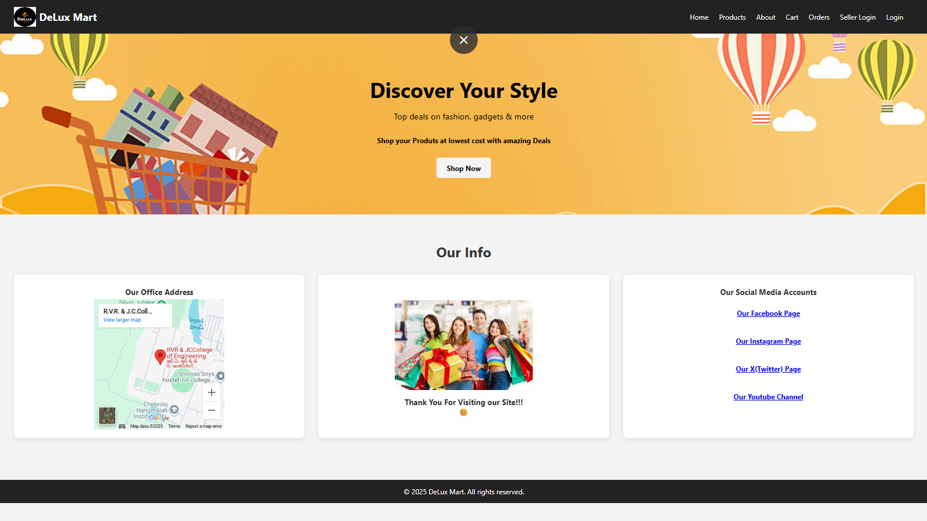
Home Page

Slide 18
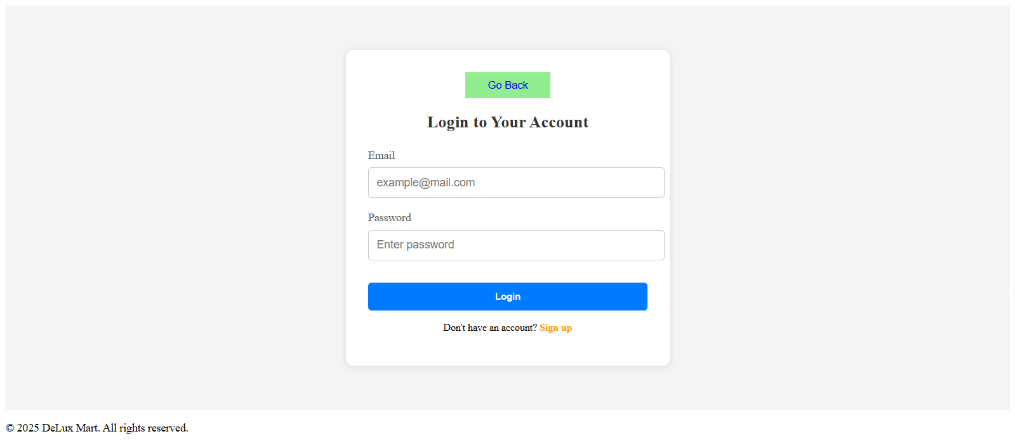
User Login

Slide 19
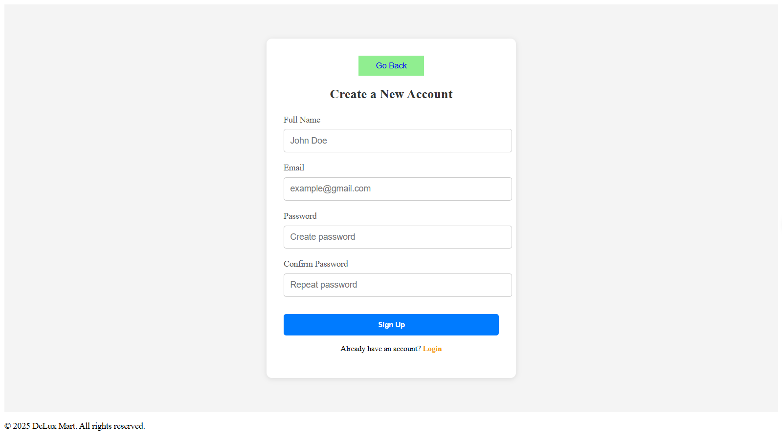
User Sign Up

Slide 20
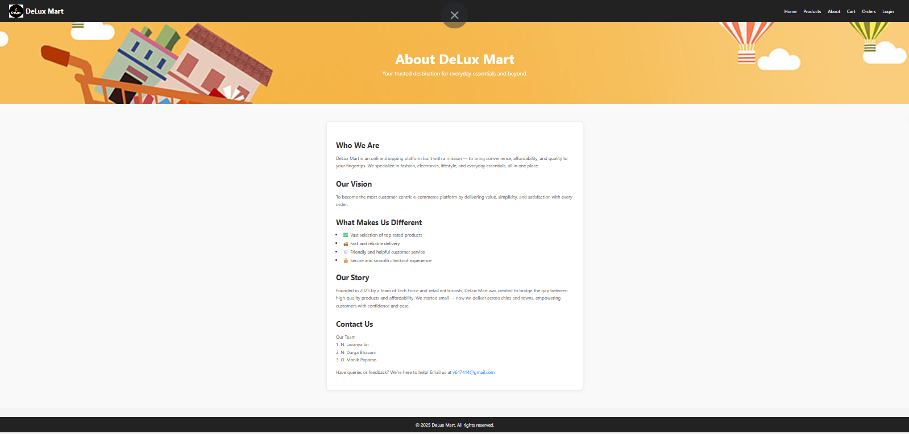
About Page

Slide 21
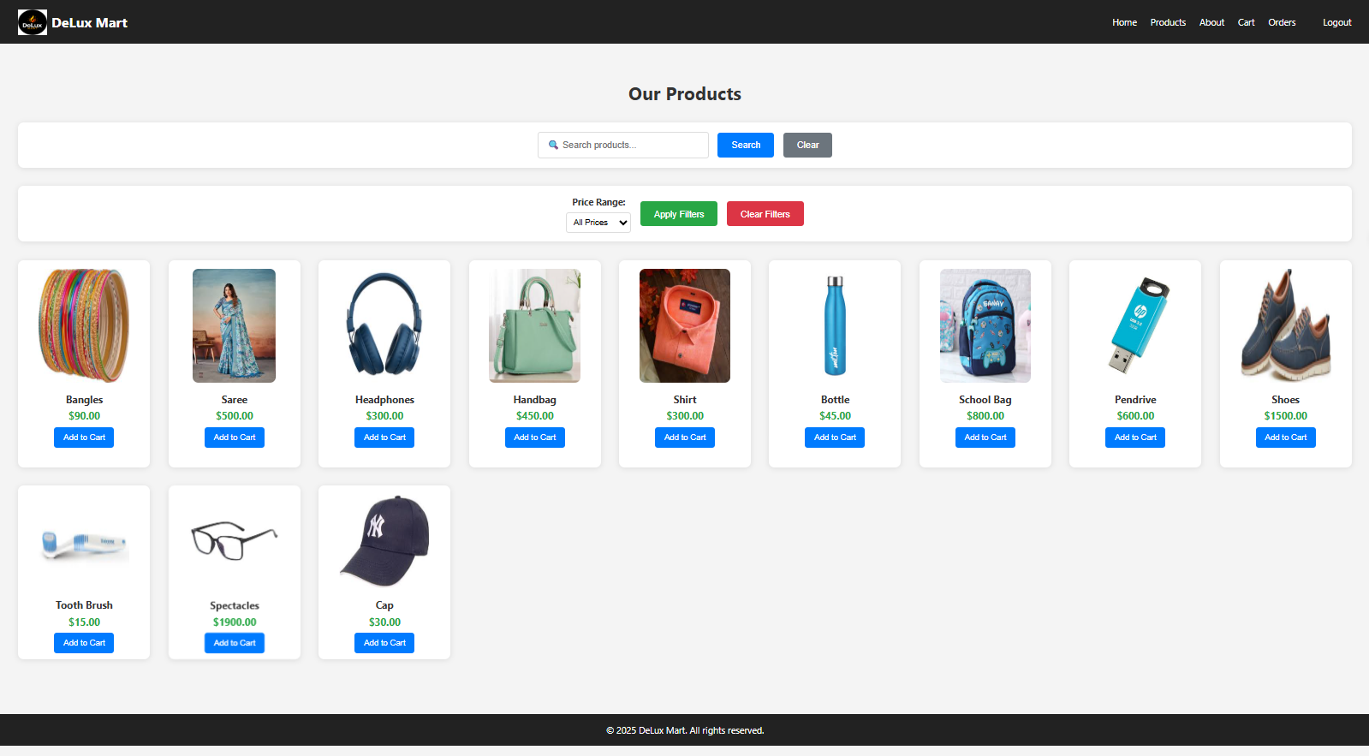
Products Page

Slide 22
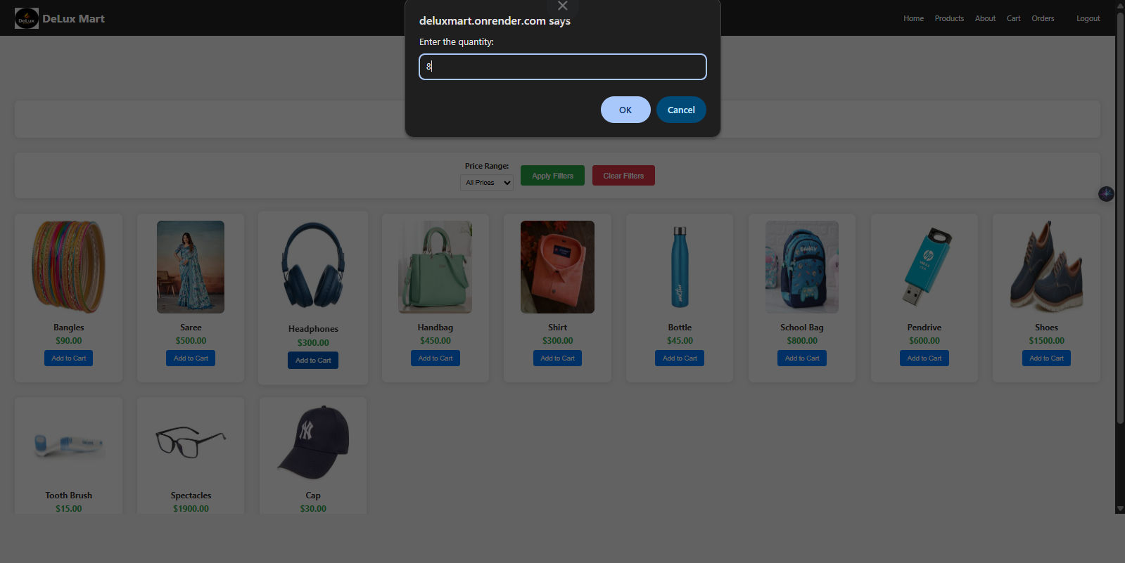
Adding to Cart

Slide 23
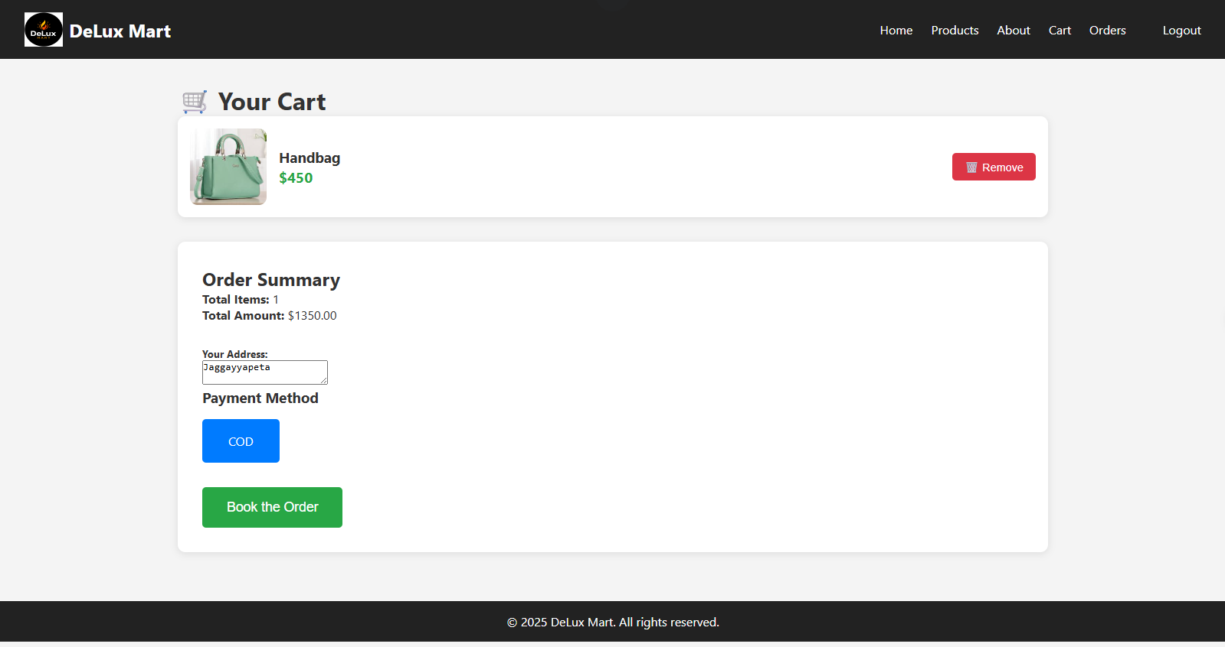
Cart and Order Booking

Slide 24
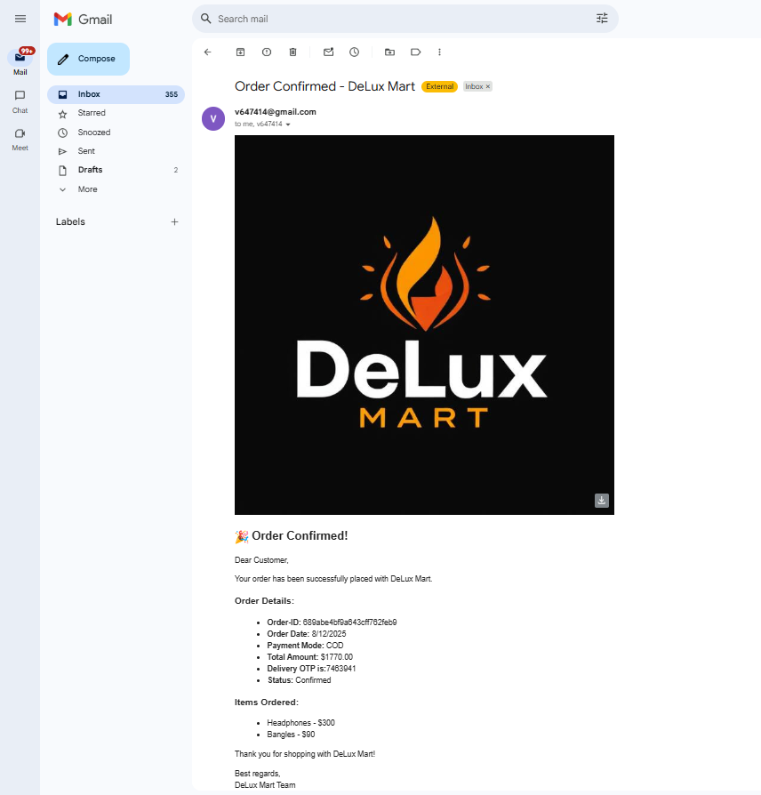
Order Confirmation Email

Slide 25
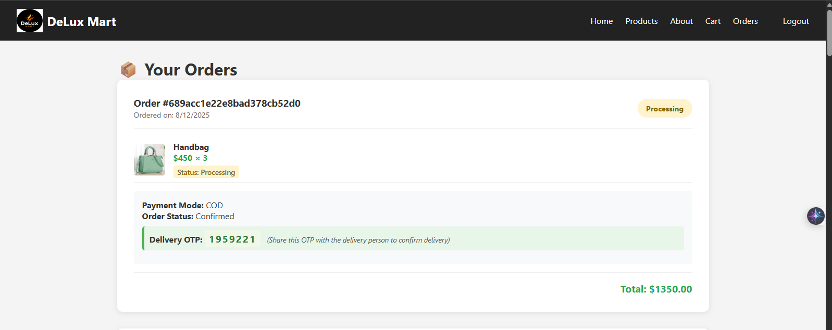
Orders Page

Slide 26
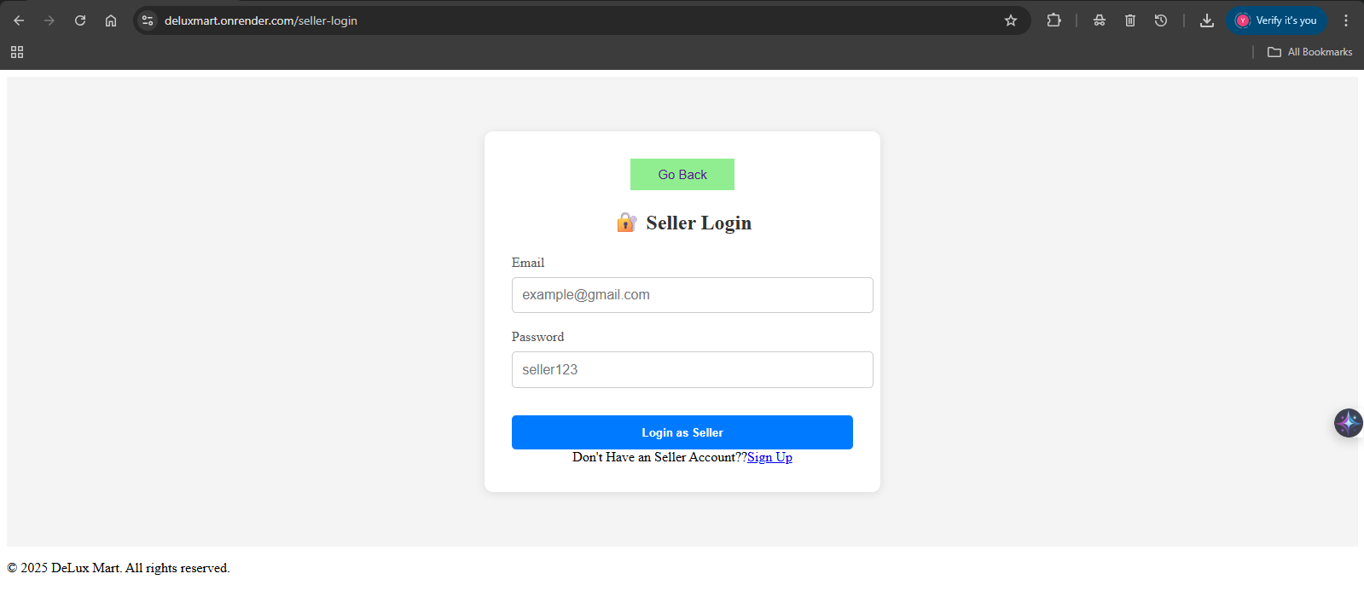
Seller Login

Slide 27
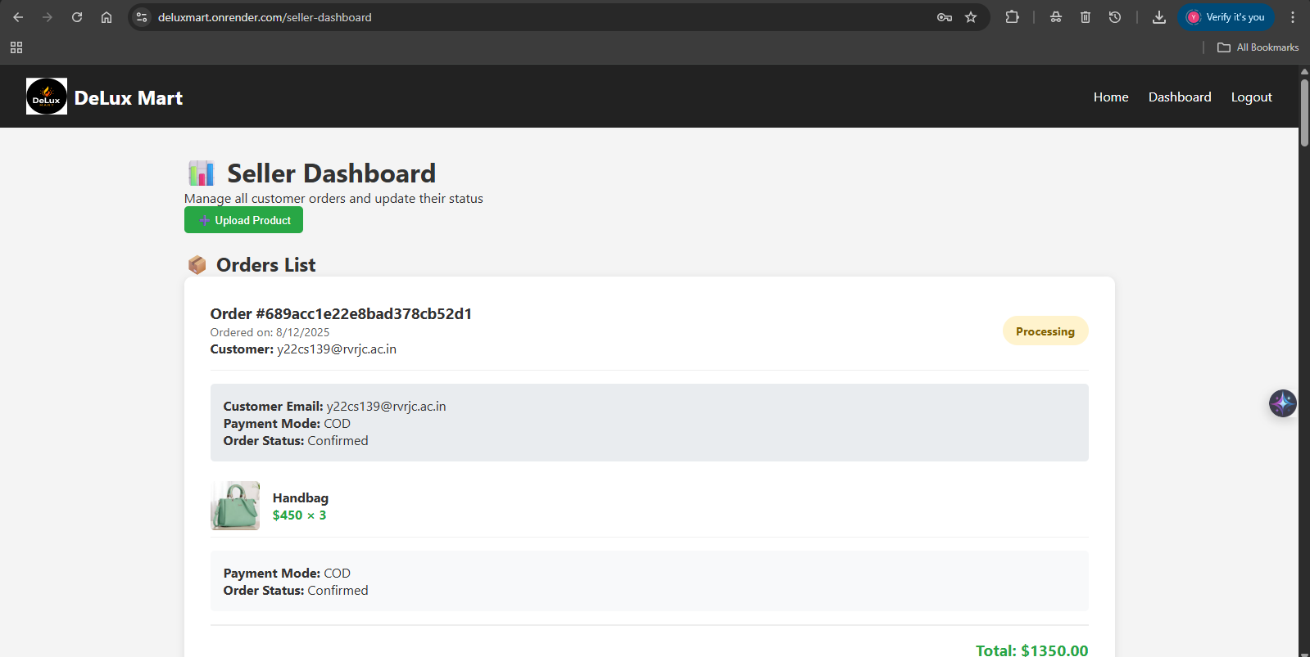
Displaying of the Orders to the Seller in Seller Dashboard

Slide 28
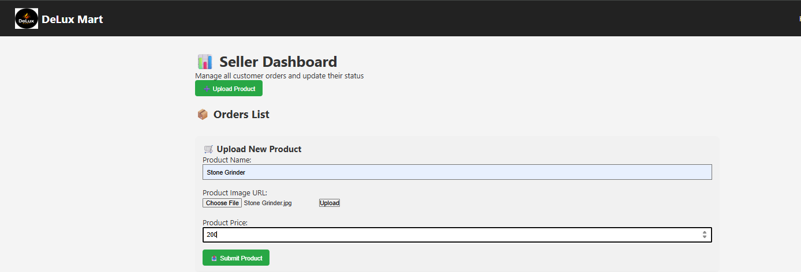
Adding Products by Seller

Slide 29
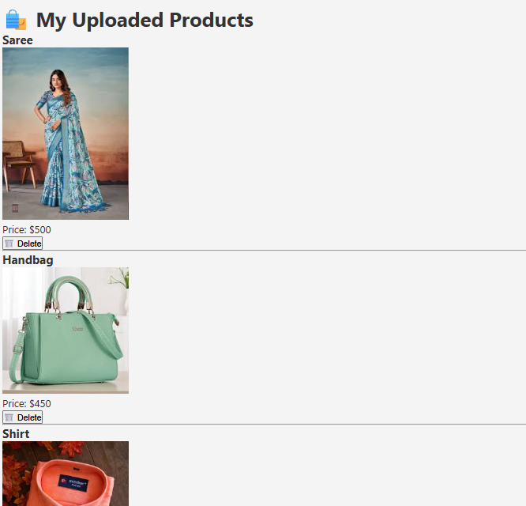
Displaying the Products of the Seller

Slide 30
Deployment
Deployed in Render
Website is DeLux Mart (https://deluxmart.onrender.com/)

Slide 31
Thank You

